Slide 1
Cloud-Based Inventory Management System
Submitted in the partial fulfillment for the award of the degree of
BACHELOR OF ENGINEERING
IN
DevOps
Submitted by:
Aaryan Maheshwari – 22BDO10001
Chayan Gope – 22BDO10036
Under the Supervision of:
Dhawan Singh (E14960)
Department of AIT-CSE
DISCOVER . LEARN . EMPOWER

Slide 2

Outline of Our Presentation
Introduction to Inventory Management
Why Cloud-Based Inventory Management?
Problem Definition
Objectives of Our Work
Proposed Solution & Its Approach
List of Required Technologies
Implementation Plan
Conclusion
Future Scope

Slide 3
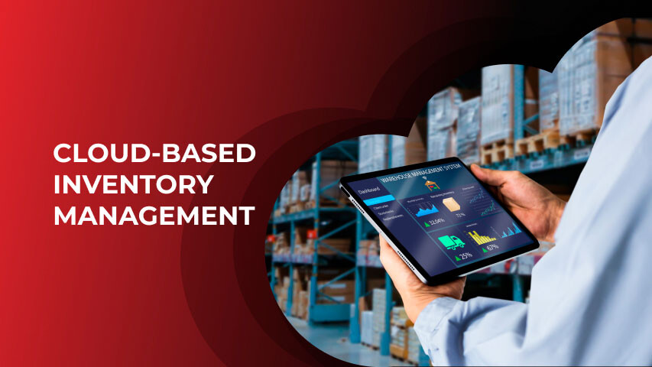
Introduction to Inventory Management
Inventory management is the process of ordering, storage, utilization, and sale of a firm's inventory.
Classic techniques — manual logs, spreadsheets — are imprecise and slow.
With today's digital age, real-time visibility and automation are essential.
Cloud-based solutions consolidate data, streamline processes, and improve decision-making, bringing about operational efficiency and cost savings.

Slide 4
Why Cloud-Based Inventory Management?
Challenges with Traditional Systems:
Manual entries lead to human errors and stock inaccuracies.
Data silos create delays and misinformed business decisions.
Inflexible systems struggle to scale with business growth.
High costs for server maintenance and IT support.
Cloud-Based Systems Offer:
Real-time, centralized visibility.
Scalability without large infrastructure costs.
Seamless integration with ERP, CRM, POS.
Secure remote access from any location.

Slide 5
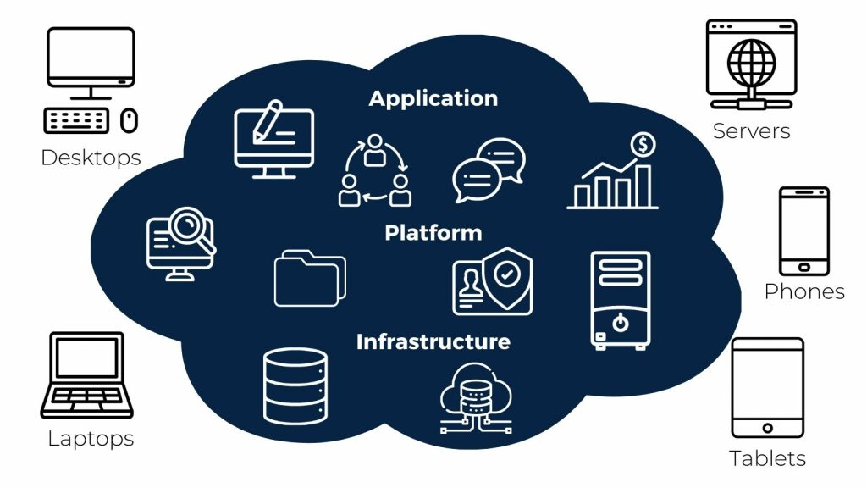
Problem Definition
The most important issue dealt with in this project is inefficiency and inefficacy of conventional inventory control systems that fail to have real-time synchronization, scalability, predictive analytics, and integration with advanced ERP and CRM systems. Lack of real-time inventory status, accurate demand forecasts, and data protection for sensitive inventory information generates serious operational threats. Organizations confronted with these problems suffer from stockouts, overstocking, loss of revenue, unhappy customers, and regulatory issues.
Therefore, there is a pressing requirement for a Cloud-Based Inventory Management System that takes advantage of cloud technologies, real-time processing, AI-based analytics, and effortless integrations to deliver a scalable, efficient, and smart solution for contemporary inventory challenges.

Slide 6
Objectives of the Work
Primary Objective:
To design and develop a cloud-based inventory management system ensuring real-time monitoring, operational accuracy, and scalability.
Secondary Objectives:
Support businesses of all sizes through a flexible, scalable platform.
Provide seamless API integration with ERP and CRM platforms.
Implement AI-driven analytics for intelligent decision-making.
Ensure enterprise-grade security to protect business data.

Slide 7
Proposed Solution & its Approach
Cloud-Native Architecture:
Deployed on AWS cloud for scalability and high availability using EC2, Lambda, S3, RDS.
Real-Time Inventory Tracking:
Instant updates with ReactJS front-end communicating with MongoDB Atlas back-end.
AI-Powered Predictive Analytics:
Using TensorFlow and Scikit-learn for demand forecasting, fast/slow mover detection, dynamic safety stock adjustments.
Seamless Integration:
Connectors for SAP, Salesforce, Zoho CRM, POS systems using middleware like Zapier or Mulesoft.
Security:
OAuth 2.0 authentication, JWT tokens, SSL encryption, GDPR and SOC2 compliance.

Slide 8
List of Required Software
Languages
Cloud Services
Frontend: ReactJS (for user dashboard and analytics visualization)
Backend: Node.js, Python
Security: SSL/TLS Encryption
Database: MongoDB Atlas (cloud-hosted NoSQL database)
Testing Tools: JMeter and Locust for load testing under concurrent users.
Cloud Infrastructure: Amazon Web Services (AWS)

Slide 9
Implementation of a Cloud-Based Inventory Management System
1. System Requirements Gathering:
Interviews and surveys to identify pain points in current inventory workflows.
2. Design Phase:
UI/UX Design: Clean, intuitive interface.
Database Schema: Collections for inventory, users, suppliers, orders.
3. Core Feature Development:
Real-time tracking, low-stock alerts, stock transfer, batch tracking.
Integration:
Developing REST APIs and integrating with external ERP and CRM platforms.
5. Testing & Validation:
Unit testing, system integration testing, performance and security testing.
6. Deployment & Training:
Hosting on AWS and training staff on system usage.

Slide 10
Conclusion
Cloud-Based Inventory Management System (CBIMS) overcomes key challenges in conventional inventory management by providing an intelligent, scalable, and real-time solution. With cloud-native architecture, predictive analytics, automatic tracking, and smooth integration with ERP and CRM systems, CBIMS maximizes operational efficiency while minimizing costs. It provides real-time visibility into multiple locations, facilitates decision-making, and maintains data security using strong protocols such as OAuth 2.0 and SSL encryption. As a whole, CBIMS converts inventory management into a proactive and strategic method, allowing businesses to attain enhanced accuracy, customer satisfaction, and sustainable development.

Slide 11

Future Scope
In the future, CBIMS can be further developed by incorporating IoT technologies such as RFID and smart sensors for even more precise real-time tracking. Blockchain can be added to ensure secure and transparent inventory records. Creating a specific mobile app will provide more flexibility for on-the-go management. Moreover, advanced AI models can be employed to enable autonomous decision-making, such as dynamic stock optimization and supplier suggestions. Regular system improvements on the basis of user responses will keep CBIMS responsive, effective, and synchronized with changing business requirements of various industries.

Slide 12
Thank you
Have a nice day!!

